Slide 1

Parallel K means clustering
using MPI
Author: Gautam Shende
CSE 633: Parallel Algorithms
Instructor: Dr. Russ Miller
Date: 08/05/2018

Slide 2
OVERVIEW
Clustering
K means
Parallel Model & Flow
Results & Inferences
Challenges
Future Scope
References

Slide 3
CLUSTERING

Slide 4
CLUSTERING
Partitioning of data into subsets called clusters
Similar elements placed in same cluster. Similarity is calculated based on some distance metric such as euclidean distance or hamming distance.
Example :
Dataset = {US, CHN, IN, CA}
No of clusters = 2
Cluster 1: US, CA
Cluster 2: CHN, IN

Slide 5
2) K-Means

Slide 6
K-MEANS FOR CLUSTERING
Select k i.e. the number of clusters
Use any strategy* to select k points to be cluster centers.
Put each point in the data set in the cluster which has its center closest to the point
Calculate new cluster centers by taking means of all points in a cluster
Repeat 3 and 4 until convergence

Slide 7
EXAMPLE
U = {1,6,10,18,3,14} , K=2
ASSUME CLUSTER CENTERS TO BE C1 = 1, C2 = 6
CLUSTER C1: {1,3}
CLUSTER C2: {6,10,18,14}
UPDATE CENTRE C1 = AVG {1,3} = 2
UPDATE CENTRE C2 = AVG {6,10,18,14} = 12
UPDATED CLUSTER C1: {1,3,6}
UPDATED CLUSTER C2: {10,18,14}
UPDATE CENTRE C1 = AVG {1,3,6} = 3.333
UPDATE CENTRE C2 = AVG {10,18,14} = 14
UPDATED CLUSTER C1: {1,3,6}
UPDATED CLUSTER C2: {10,18,14}
NO CHANGE IN CLUSTER CONFIGURATION (CONVERGENCE)
-> STOP <-

Slide 8
PARALLEL K-MEANS
Allot k cluster centers to the nodes(n) equally such that each node is responsible for (k/n) clusters.
Now Each node does the following
Calculate centers of (k/n) clusters by mean
Broadcast (k/n) centers to all other nodes
Receive (k/n) centers from every other node
Calculate distance of all points from all centers and find closest cluster
Send and receive points (internal and external transfers)
3. Repeat until Convergence (stopping condition)
No internal/external transfers
<-> Centers remain constant

Slide 9
3) PARALLEL MODEL & FLOW

Slide 10
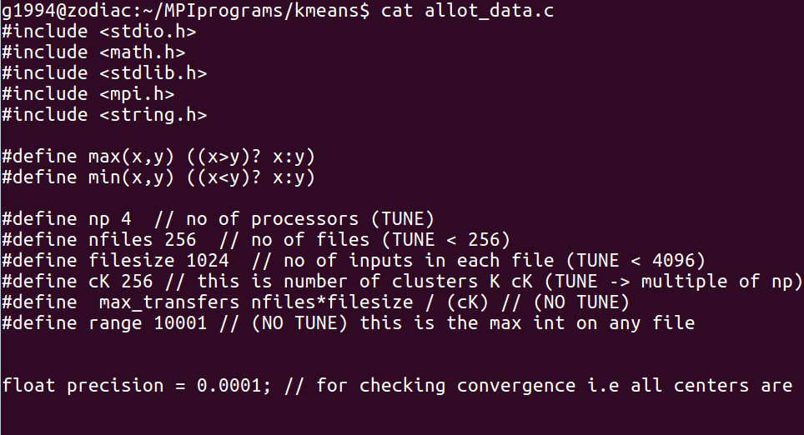
MODEL PARAMETERS
*local parameter = Max iterations (=300)
Complexity: O(input*K*iterations*dimensions)
= O(nfiles*filesize*cK*max_iterations*1)
= ~(256*1024*256*300) = ~2*10^10 =~20 billion calculations
Repository: https://github.com/thezodiac1994/Parallel-Alogrithms

Slide 11
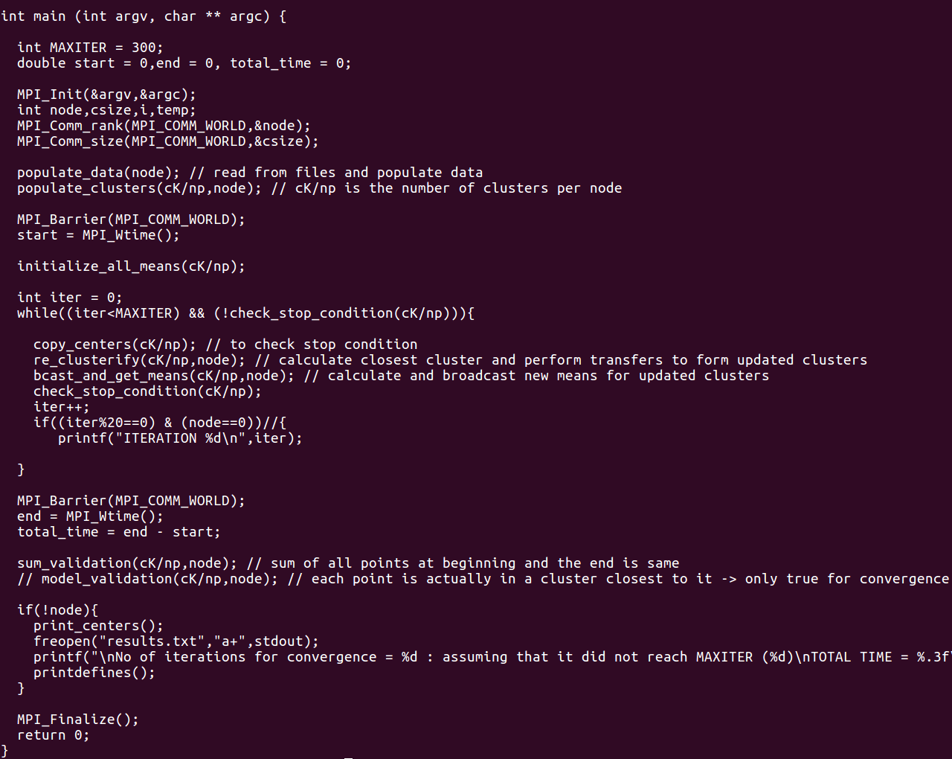
FLOW OF PARALLEL PROGRAM

Slide 12
4) RESULTS & INFERENCES

Slide 13
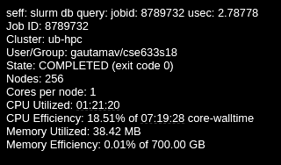
RESULTS & INFERENCES
(First things first)

Slide 14
Nodes vs Time
cK = 256, inpsize = 262,144, iterations = 106 (convergence)
nodes | t0 | t1 | t2 | t3 | t4 | avg
256 | 6.531 | 6.538 | 6.674 | 6.536 | 6.53 | 6.562
128 | 8.28 | 8.428 | 8.242 | 8.298 | 8.282 | 8.306
64 | 10.526 | 10.54 | 10.698 | 10.548 | 10.78 | 10.618
32 | 14.42 | 14.405 | 14.393 | 14.543 | 14.392 | 14.431
16 | 18.104 | 18.114 | 18.092 | 18.09 | 17.388 | 17.746
8 | 21.214 | 21.201 | 21.201 | 21.211 | 21.578 | 21.281
4 | 27.329 | 27.305 | 27.328 | 27.312 | 27.353 | 27.352
2 | 38.61 | 38.632 | 38.64 | 38.62 | 38.6 | 38.621
1 | 59.317 | 59.378 | 59.425 | 59.352 | 59.349 | 59.364

Slide 15
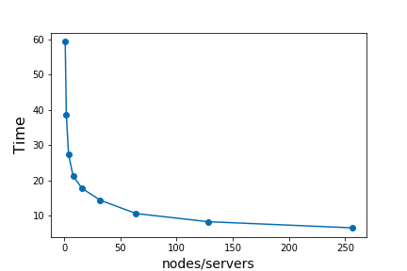
Nodes vs Time
Nodes | 1 | 2 | 4 | 8 | 16 | 32 | 64 | 128 | 256
Time(s) | 59.364 | 38.621 | 27.352 | 21.281 | 17.746 | 14.431 | 10.618 | 8.306 | 6.562

Slide 16
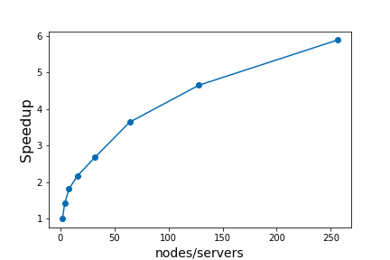
b) SPEEDUP (starting n=2)
Nodes | 2 | 4 | 8 | 16 | 32 | 64 | 128 | 256
Speedup | 1.0 | 1.411 | 1.814 | 2.176 | 2.676 | 3.637 | 4.649 | 5.886

Slide 17
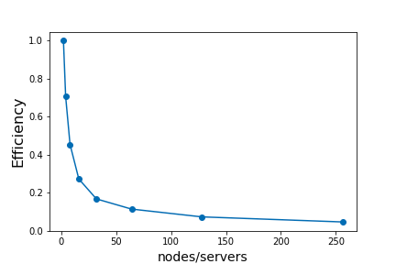
c) EFFICIENCY (starting n=2)
Nodes | 2 | 4 | 8 | 16 | 32 | 64 | 128 | 256
Efficiency | 1.0 | 0.705 | 0.453 | 0.272 | 0.167 | 0.114 | 0.073 | 0.046

Slide 18
d) Nodes vs Time
increasing data with nodes
cK = 256
nodes | data | #iter | t0 | t1 | t2 | t3 | t4 | avg
128 | 131072 | 116 | 5.173 | 5.198 | 5.211 | 5.089 | 5.064 | 5.1185
64 | 65536 | 101 | 3.879 | 3.878 | 3.88 | 3.88 | 3.874 | 3.8765
32 | 32768 | 105 | 2.025 | 2.019 | 2.024 | 2.025 | 2.017 | 2.021
16 | 16384 | 112 | 1.429 | 1.432 | 1.434 | 1.431 | 1.445 | 1.437
8 | 8192 | 118 | 0.965 | 0.97 | 0.966 | 0.969 | 0.941 | 0.953
4 | 4096 | 103 | 0.574 | 0.575 | 0.579 | 0.573 | 0.574 | 0.574
2 | 2048 | 2 | 0.011 | 0.011 | 0.011 | 0.011 | 0.01 | 0.0105
1 | 1024 | 1 | 0.009 | 0.005 | 0.007 | 0.008 | 0.008 | 0.0085

Slide 19
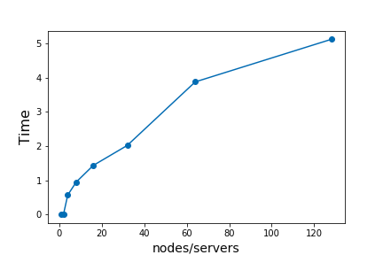
d) Nodes vs Time
increasing data with nodes
Nodes | 1 | 2 | 4 | 8 | 16 | 32 | 64 | 128
Time(s) | 0.008 | 0.010 | 0.574 | 0.953 | 1.437 | 2.021 | 3.876 | 5.118
Data (x = 2^10) | x | 2x | 4x | 8x | 16x | 32x | 64x | 128x

Slide 20
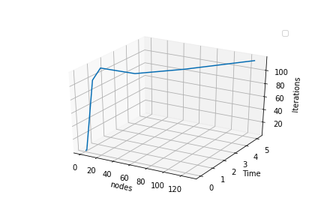
d) Nodes vs Time
increasing data with nodes (considering iterations)
Nodes | 1 | 2 | 4 | 8 | 16 | 32 | 64 | 128
Time | 0.008 | 0.010 | 0.574 | 0.953 | 1.437 | 2.021 | 3.876 | 5.118
Data (x = 2^10) | x | 2x | 4x | 8x | 16x | 32x | 64x | 128x
Iterations | 1 | 2 | 103 | 118 | 112 | 105 | 101 | 116

Slide 21
e) Varying cpus per node
cK = 256, inpsize = 262144, nodes*cpus = 32
nodes | cpus | t0 | t1 | t2 | t3 | avg
2 | 16 | 16.026 | 18.446 | 17.73 | 17.035 | 16.531
4 | 8 | 14.457 | 14.46 | 14.439 | 14.423 | 14.44
8 | 4 | 14.396 | 14.411 | 14.394 | 14.419 | 14.408
16 | 2 | 14.68 | 14.617 | 14.656 | 14.396 | 14.538
32 | 1 | 14.42 | 14.405 | 14.426 | 14.419 | 14.418

Slide 22
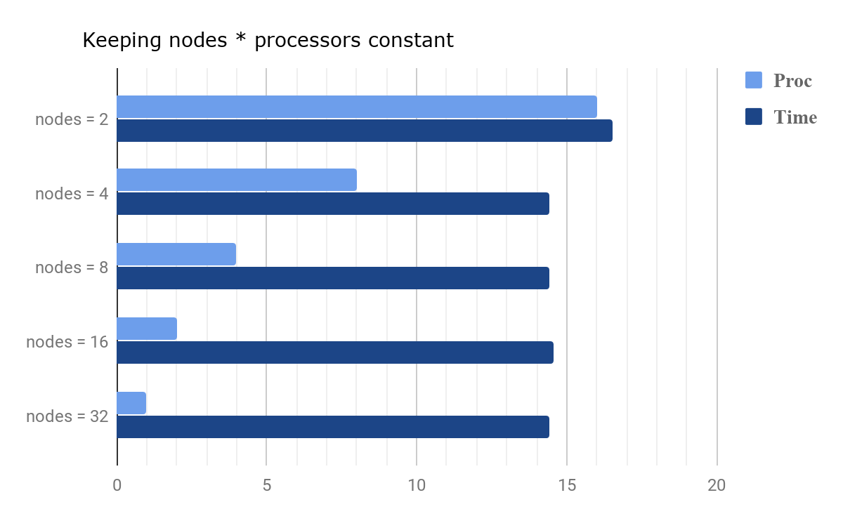
e) Varying cpus per node
Nodes , cpus | 2,16 | 4,8 | 8,4 | 16,2 | 32,1
Time(s) | 16.531 | 14.44 | 14.408 | 14.538 | 14.418

Slide 23
f) Varying input size
np = 32, cK = 256
np = 16, cK = 256
inpsize | t0 | t1 | t2 | t3 | avg | iterations | avg/iter
4x = 262144 | 14.404 | 14.404 | 14.406 | 14.399 | 14.40325 | 106 | 0.136
3x = 196608 | 13.273 | 13.264 | 13.255 | 13.275 | 13.26675 | 123 | 0.108
2x = 131072 | 8.622 | 8.627 | 8.648 | 8.625 | 8.6305 | 130 | 0.066
x = 65536 | 4.494 | 4.491 | 4.497 | 4.497 | 4.49475 | 129 | 0.035
inpsize | t0 | t1 | t2 | t3 | avg | iterations | avg/iter
4x = 262144 | 27.091 | 27.093 | 27.081 | 27.094 | 27.08975 | 106 | 0.256
3x = 196608 | 17.698 | 17.73 | 17.732 | 17.716 | 17.719 | 123 | 0.144
2x = 131072 | 11.121 | 11.12 | 11.123 | 11.118 | 11.1205 | 130 | 0.085
x = 65536 | 5.317 | 5.31 | 5.318 | 5.315 | 5.315 | 129 | 0.041

Slide 24
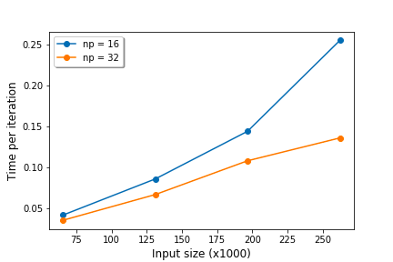
f) Varying input size
InpSize | x | 2x | 3x | 4x
Time/Iteration (np = 16) | 0.041 | 0.085 | 0.144 | 0.256
Time/Iteration (np = 32) | 0.035 | 0.066 | 0.108 | 0.136
*time/iter so we don’t have to consider the third variable/dimension (iterations) separately

Slide 25
g) Varying cK
inpsize = 262144, nodes = 16, iterations = c
inpsize = 262144, nodes = 32, iterations = c
ck | t0 | t1 | t2 | avg
512 | 0.303 | 0.306 | 0.301 | 0.302
768 | 1.237 | 1.234 | 1.238 | 1.2375
1024 | 1.694 | 1.701 | 1.701 | 1.6975
1280 | 5.583 | 5.585 | 5.599 | 5.591
ck | t0 | t1 | t2 | avg
512 | 0.167 | 0.17 | 0.166 | 0.1665
768 | 0.547 | 0.548 | 0.55 | 0.5485
1024 | 1.043 | 1.044 | 1.044 | 1.0435
1280 | 2.258 | 2.26 | 2.263 | 2.2605
* Ran for low no of fixed iterations, because the motive was to see the effect of k and not reach convergence. Constant iterations eliminates the need to consider it explicitly as an extra variable/dimension affecting the graph

Slide 26
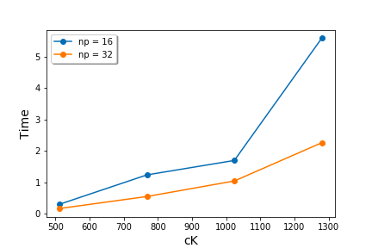
g) Varying cK
cK (x=256) | 2x | 3x | 4x | 5x
Time (np = 16) | 0.302 | 1.237 | 1.697 | 5.591
Time (np = 32) | 0.1665 | 0.5485 | 1.0435 | 2.2605

Slide 27
h) Inferences
For my model, 16-32 nodes are ideal from the point of view of efficiency and improvement in running times.
When keeping nodes * cpus = 32, the combination., there is not much deviation but nodes = 4, cpus = 8 was found to work best. Too many cpus on one node saturates it and too few increases communication cost.
Increasing cK has more impact on running time as in comparison to adding more uniformly distributed data.
It is important to also consider the number of iterations while scaling the model (input).

Slide 28
5) CHALLENGES

Slide 29
CHALLENGES
Getting access to servers
5 days -> 256 nodes
4 days -> 128 nodes
2 days -> 64 nodes
Sequencing of Parallel events
Hyper tuning parameters
cK, nP, cores/node, input size, etc
Validation of the algorithm

Slide 30
6) FUTURE SCOPE

Slide 31
FUTURE SCOPE
Implement on a multidimensional dataset
Apply to a real world clustering problem
See how different variations of the algorithm perform in terms of time and number of iterations (like choosing a different distance metric, different strategy to initialise clusters, etc)
Implement a similar model on OpenMP and CUDA

Slide 32
7) REFERENCES

Slide 33
REFERENCES
Algorithms Sequential & Parallel: A Unified Approach
(Dr. Russ Miller, Dr.Laurence Boxer)
https://ubccr.freshdesk.com/support/solutions/articles/13000026245-tutorials-and-training-documents
(Dr. Matthew Jones)
A Parallel K-Means Clustering Algorithm with MPI
(Jing Zhang, Gongqing Wu, Xuegang Hu, Shiying Li, Shuilong Hao)
https://www.buffalo.edu/ccr/support/ccr-help.html
(UB CCR help)
Stackoverflow (for general MPI questions)

